Slide 1

GOAL-BASED WEALTH MANAGEMENT WITH REINFORCEMENT LEARNING
ML3 –BOWEN FANG, BOTAO ZHANG, CHONGYI CHIE, AND YICHEN YAO
Notes:
Hello Everyone, We are the ML3 team and Our topic is Goal-based wealth management with reinforcement learning.

Slide 2



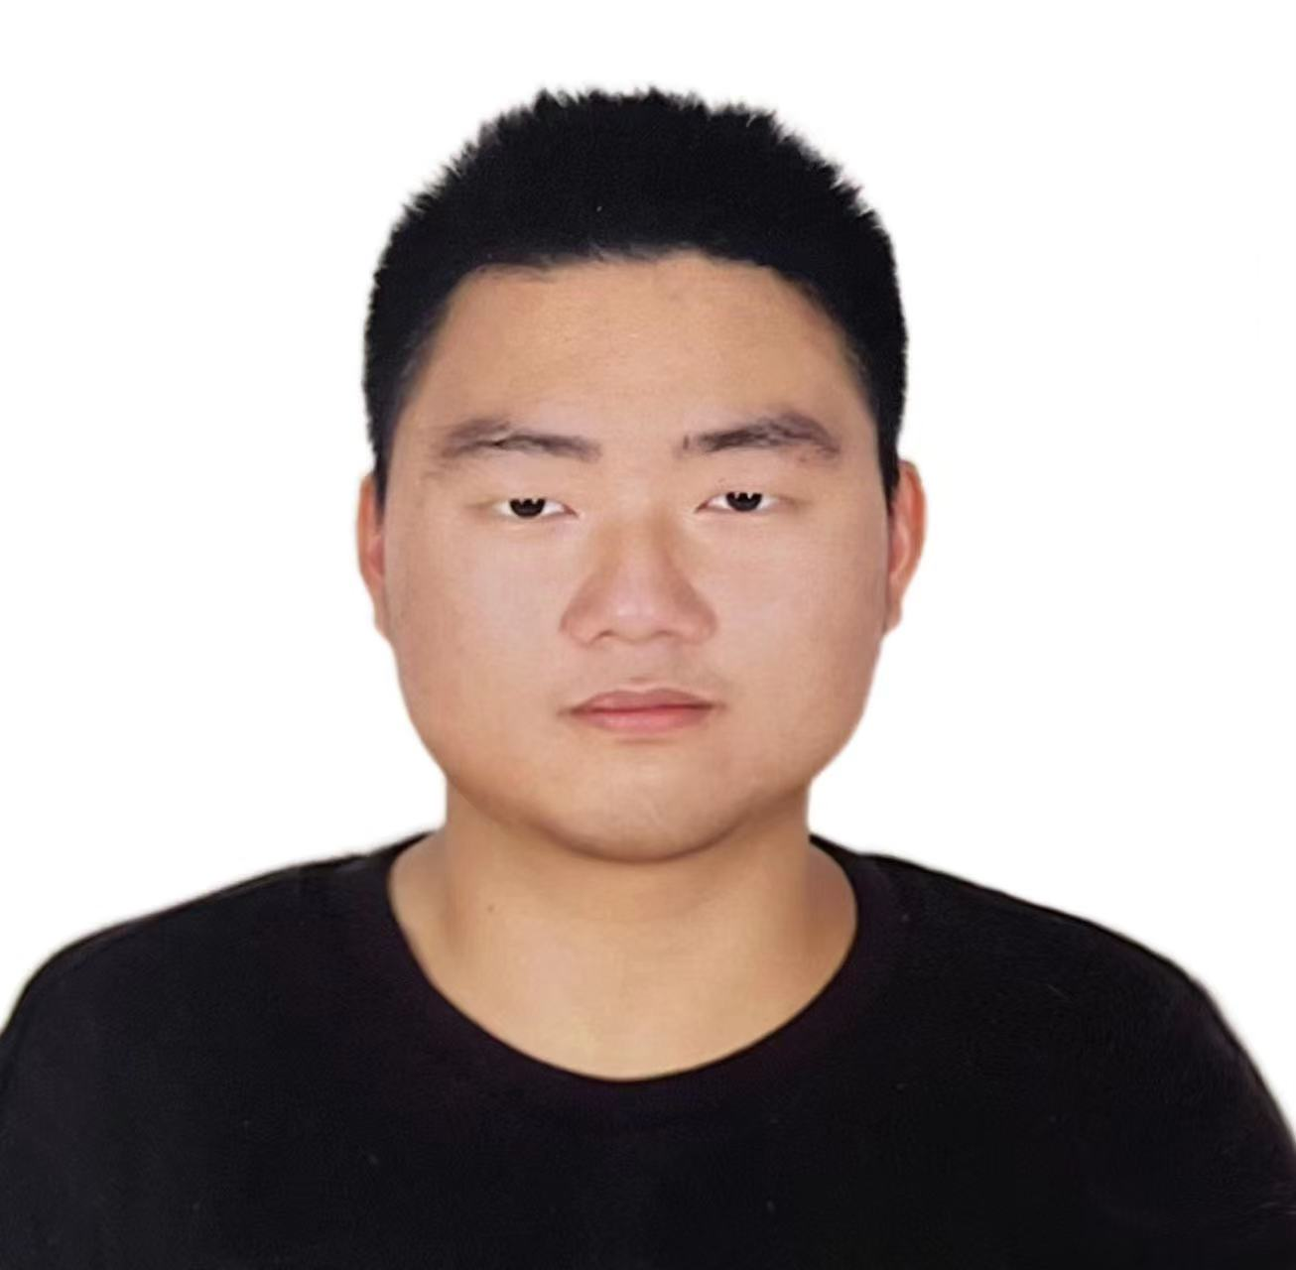

MEET THE TEAM
Chongyi Chie
MSOR
Bowen Fang
MSOR
Botao Zhang
MSOR
Yichen Yao
MSOR
Notes:
This is our team page. We are all MSOR fist-year students.

Slide 3
AGENDA
Application of the Proposed RL Algorithm
Why Choose RL over Dynamic Programming?
Motivation
Problem Statement
Key Idea
Approximation:
Agents
Environments
System Overview
Notes:
This is our agenda. We will start with introducing the application of our Reinforcement learning algorithm.

Slide 4
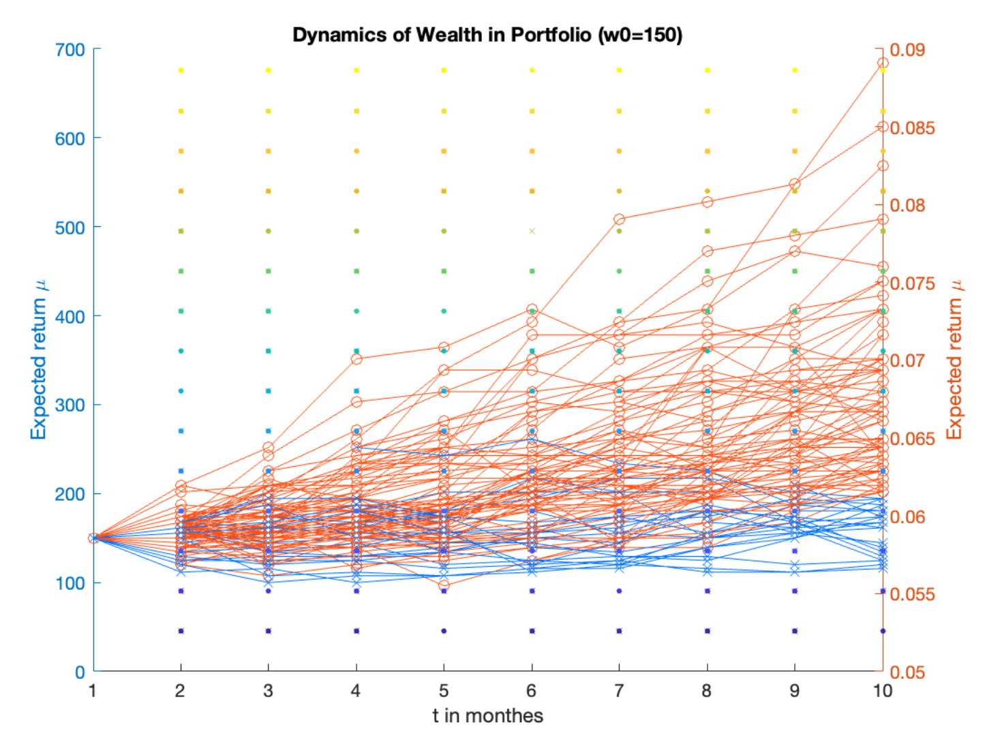
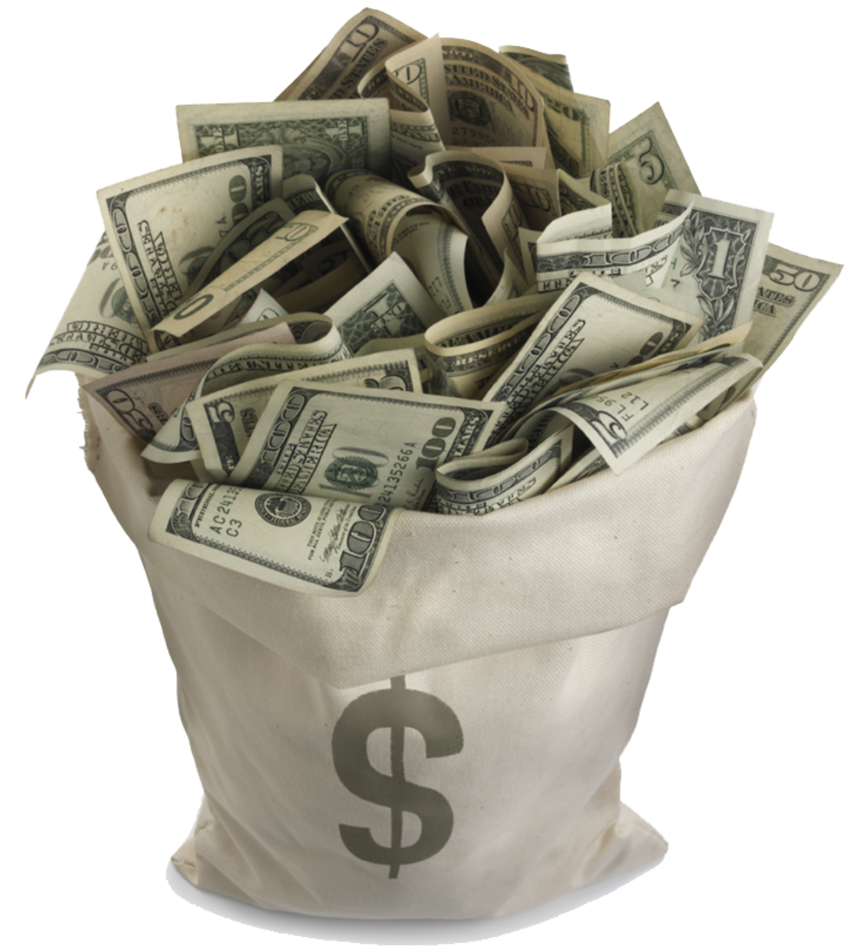

Application of the Proposed RL Algorithm

Slide 5


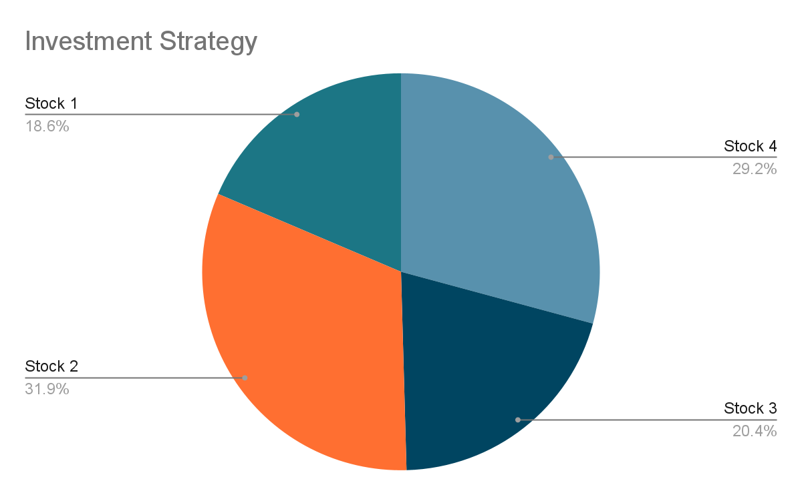
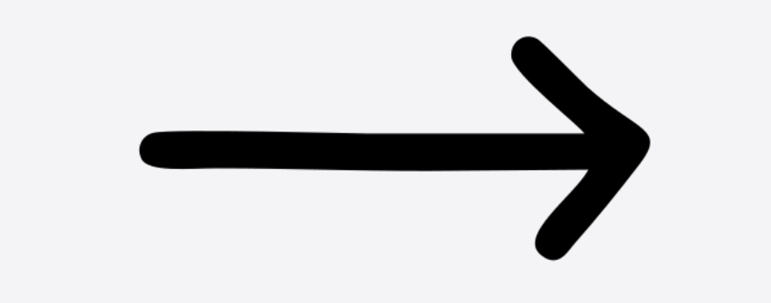
Application of the Proposed RL Algorithm
Return
Risk
Stock 1
Stock 4
Stock 2
Stock 3

Slide 6
Defect of the Still Modern Portfolio Theory
This does not work:
1) stock price changes are complex and often impossible to precisely estimate; and
2) choices should be made online with noisy inputs and perform effectively under various situations.

Slide 7
Requirement for the System
To maximize the Hit Ratio to the expected cumulative return during an investment cycle:
Reallocate the funds we placed into portoflo in order to dynamically balance risk and return
Control the risk based on the horizon, i.e. the amount of money we have and the time it will take to reach the goal.

Slide 8
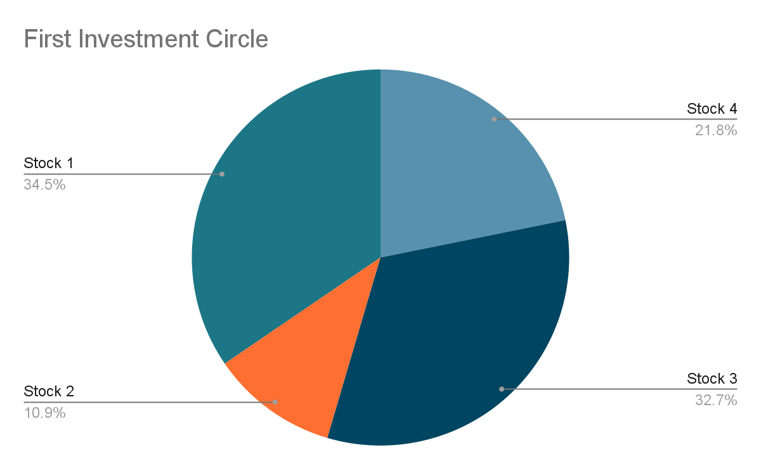


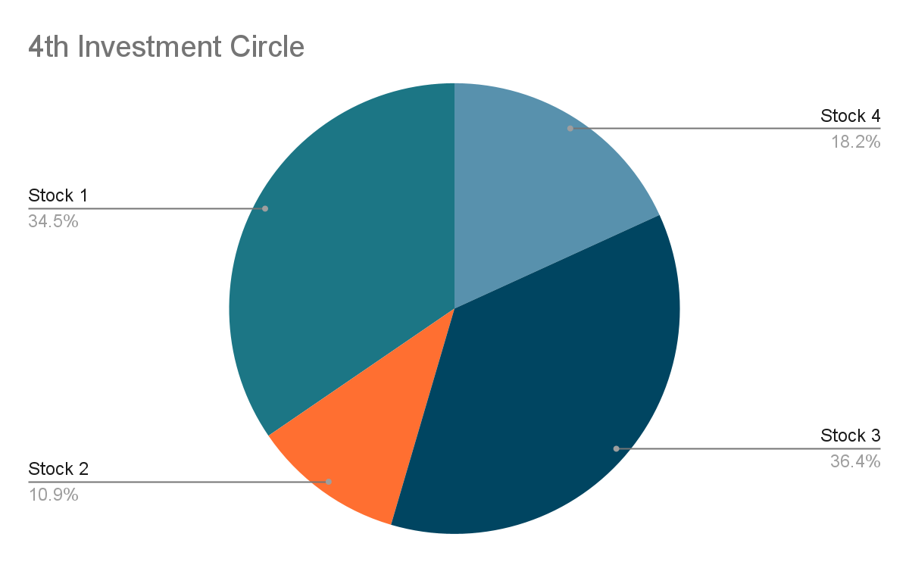

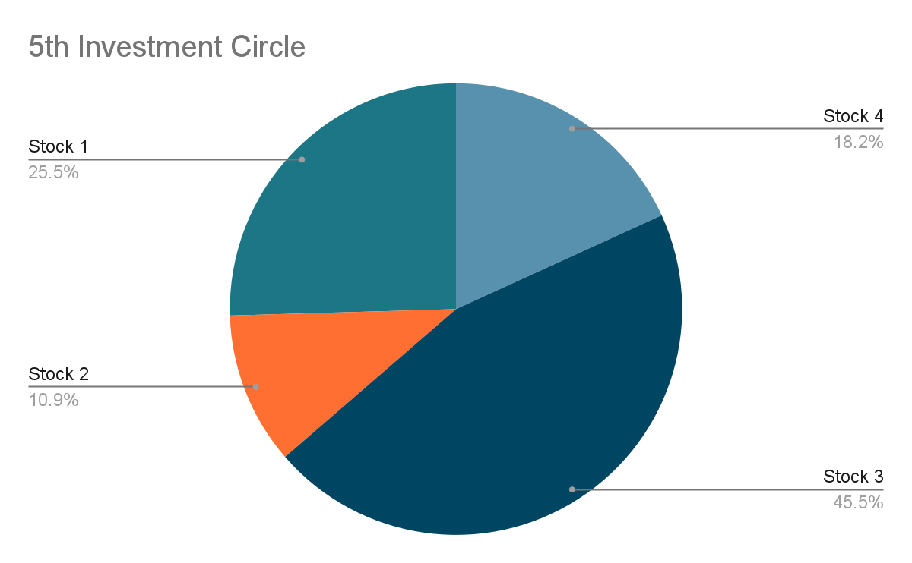
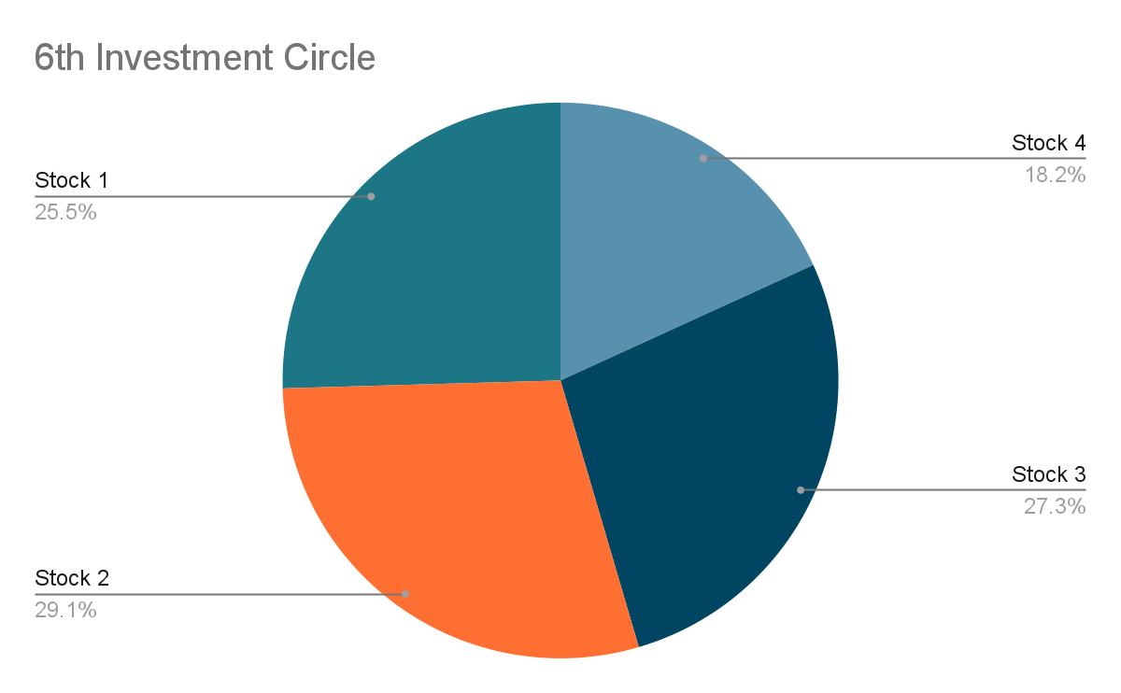

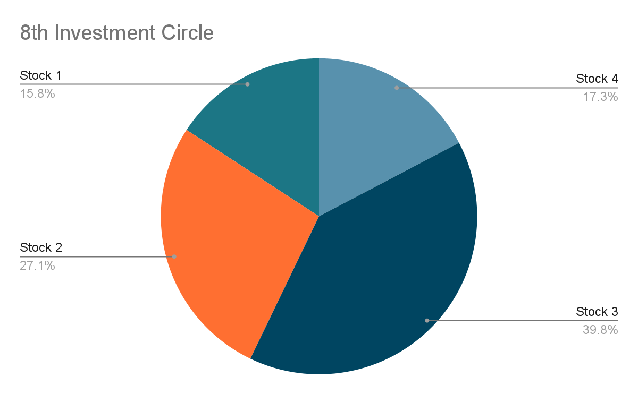
What Investors Should Perform
Expected Return
RL System
Invest
Investment Period

Slide 9
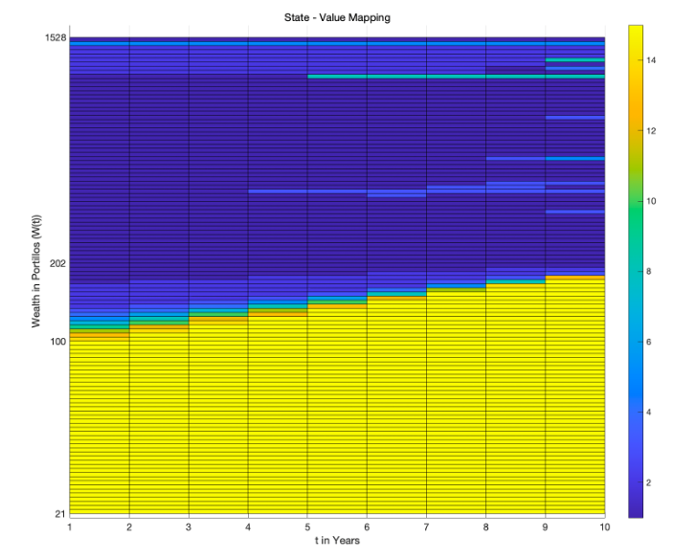
Why Choose RL over Dynamic Programming?
Transition probability of securities’ price is unknown in real-world. To estimate the transition probability is a harder task. RL could learn without knowledge of trans. prob.
However, DP provides theoretical optimal solution. We regard DP as a benchmark to RL solutions.
Defensive:
Lower expected return, lower volatility
The optimal success probability is ~66%
Aggressive:
Higher expected return, higher volatility
Notes:
So, there is one question here, why we need to choose Reinforcement learning over dynamic programming? When we use the dynamic programming to choose the action, we need to know the transition probability of securities’ price, which is unknown in the real world and required a lot of calculations to estimate. In contrast to it, reinforcement learning could learn without knowing the exact transition probability. However, at the beginning, we still used dynamic programming to solve our problem, because it will provide a theoretical optimal solution for us, and we regard it as a benchmark to our reinforcement learning solutions. The graph below shows what kind of policy the model will choose in different time slots and wealth, the yellow area means it will choose aggressive policy, which has higher expected return and higher volatility, and the blue area means it will choose defensive policy, which means lower expected return and lower volatility. The overall success probability is about 66%, which is also our theoretical optimal solution.

Slide 10
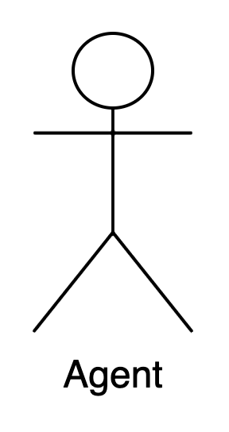
Motivation
Developing a RL algorithm which solves GBWM problem with limited observation over the large entire state space is "mission-impossible".
We developed a RL algorithm that approximates the optimal solution.
GBWM state space
Agents could visit 10% of rows ( others are extremely rare, but important! )
Since the learning of a proper strategy over all possible states is difficult in tabular RL, we have turned to approximation
100x-1000x
rows
10x-100x
cols
Notes:
Initially we were asked to use the q learning agent which is a tabular agent. You can see on the left side is an intuitive version of goal based wealth management state space. You can consider it as a very big table Normally, agents could visit 10 percent of the rows, the other 90 percent of rows very important but very hard for agent to visit. So for a tabular agent like Q learning it is hard to learn a proper strategy over all possible states. That’s why we turned to approximation We are going to show you a RL algorithm that approximate the optimal solution fast and nice.

Slide 11
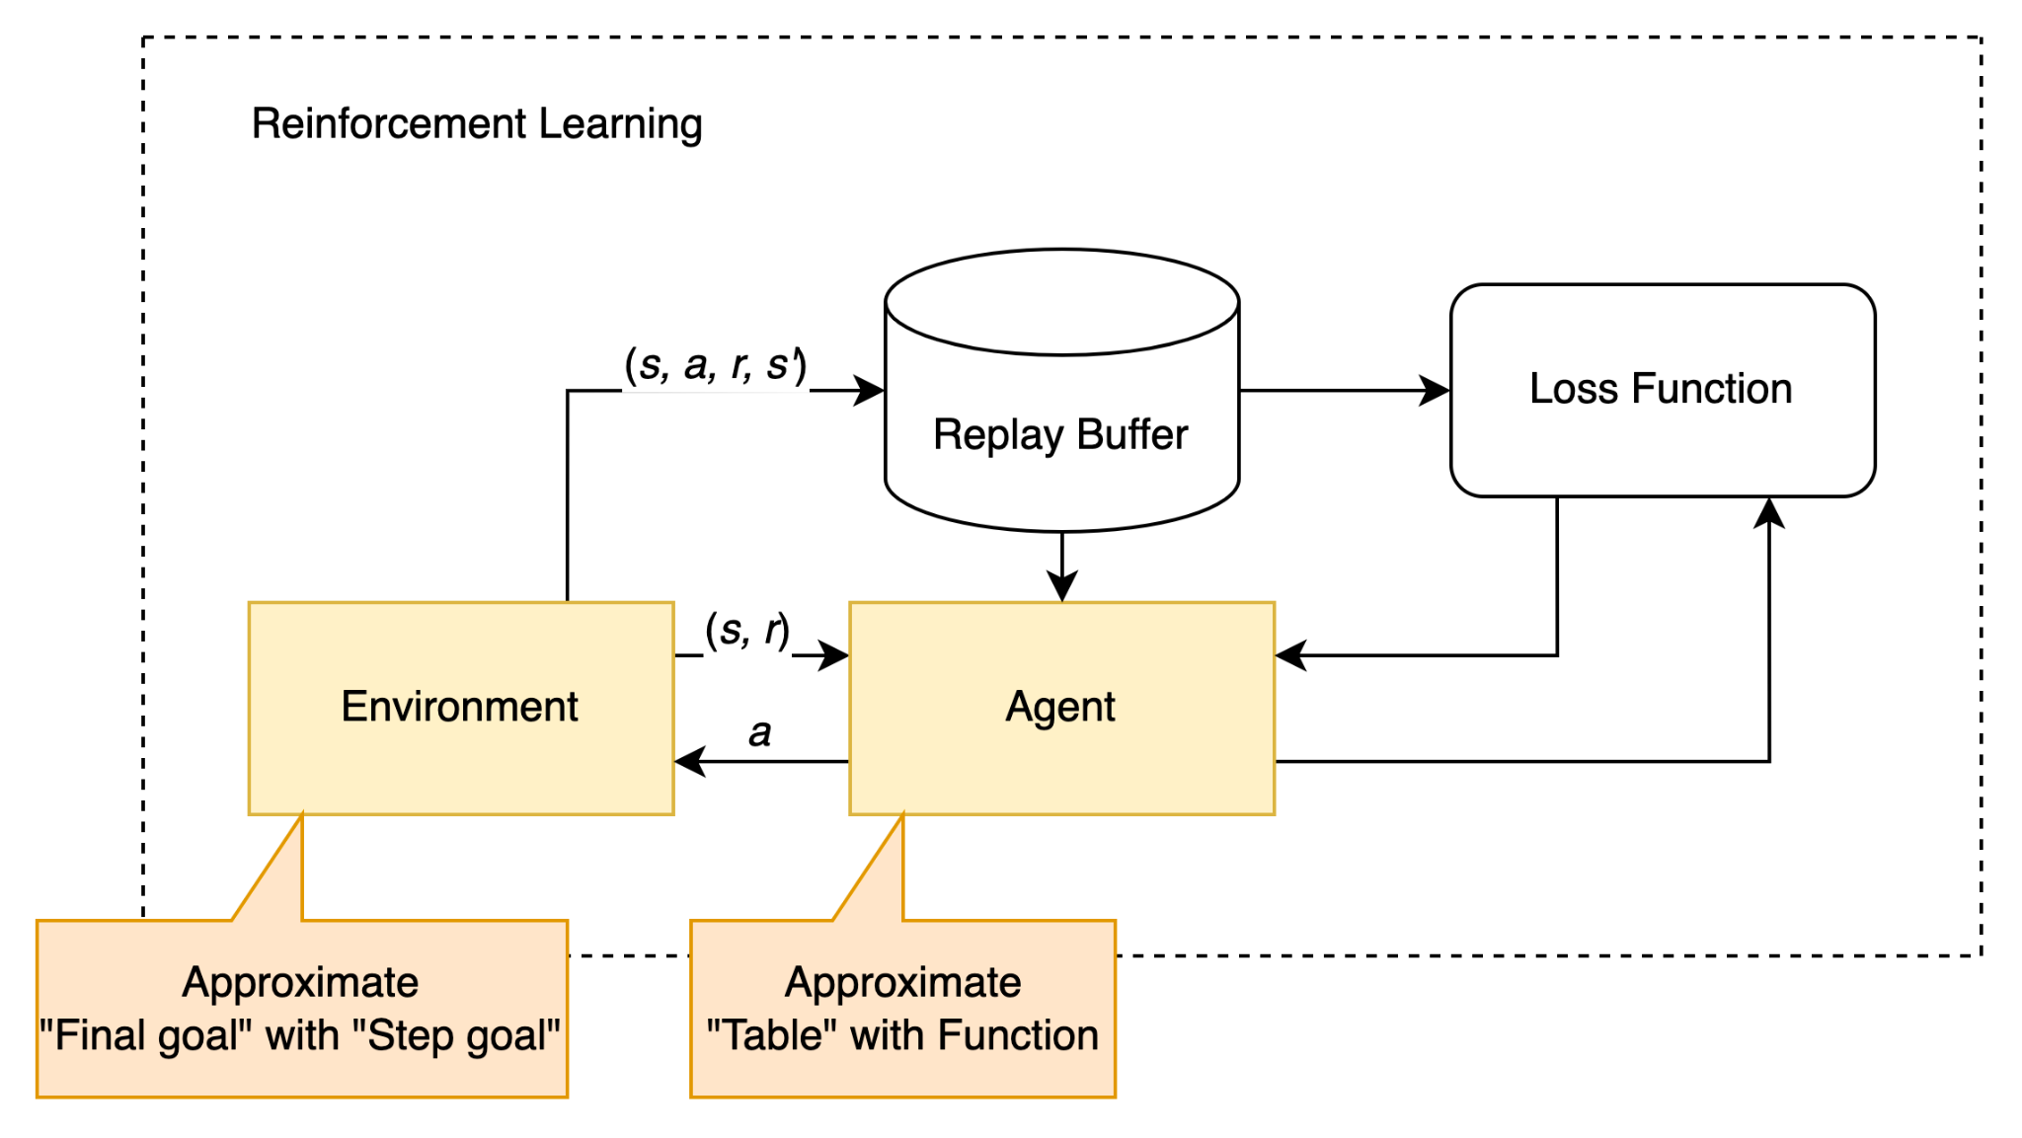
Key Idea
Approximation guides RL agent acts properly in real-world environment
We approximate Table with Deep Learning network
We approximate Sparse reward with stepwise reward
Notes:
The key idea is that approximation guides RL agent to act properly in real-world environments. So for reinforcement learning agent, we approximate the table of state space with deep learning network and for the environment we approximate sparse reward with stepwise reward.

Slide 12
Basic RL Problem Statement
The agent chooses a portfolio from efficient frontier at each rebalancing period, to maximize the probability that the goal wealth region is reached.
State: 1x2 vector [wealth, timestamp]
Action: Int [1, 15]
Transition: GBM
Reward: 1 if timestamp=T and wealth >= goal, 0 otherwise
action 1
transition prob
goal wealth
Wealth
Initial wealth
Timestamps

Slide 13
Basic RL Problem Statement
The agent chooses a portfolio from efficient frontier at each rebalancing period, to maximize the probability that the goal wealth region is reached.
State: 1x2 vector [wealth, timestamp]
Action: Int [1, 15]
Transition: GBM
Reward: 1 if timestamp=T and wealth >= goal, 0 otherwise
action 1
transition prob
goal wealth
Wealth
Initial wealth
Timestamps

Slide 14
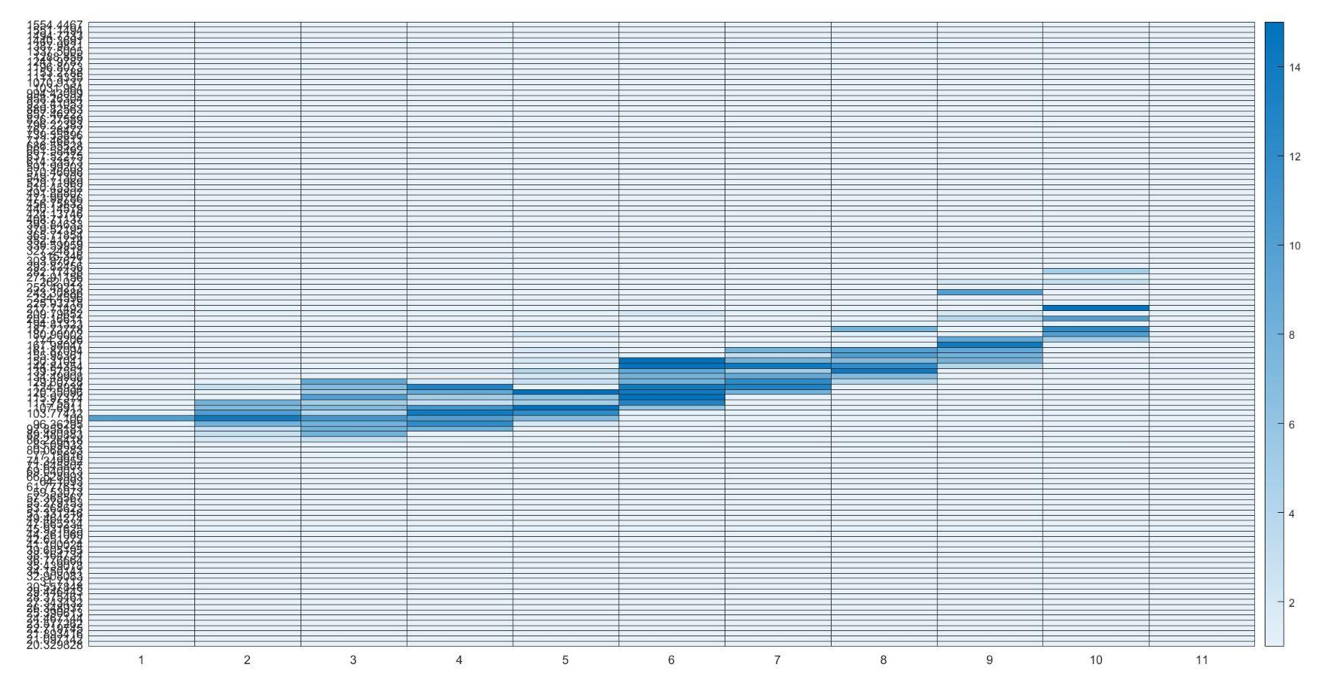
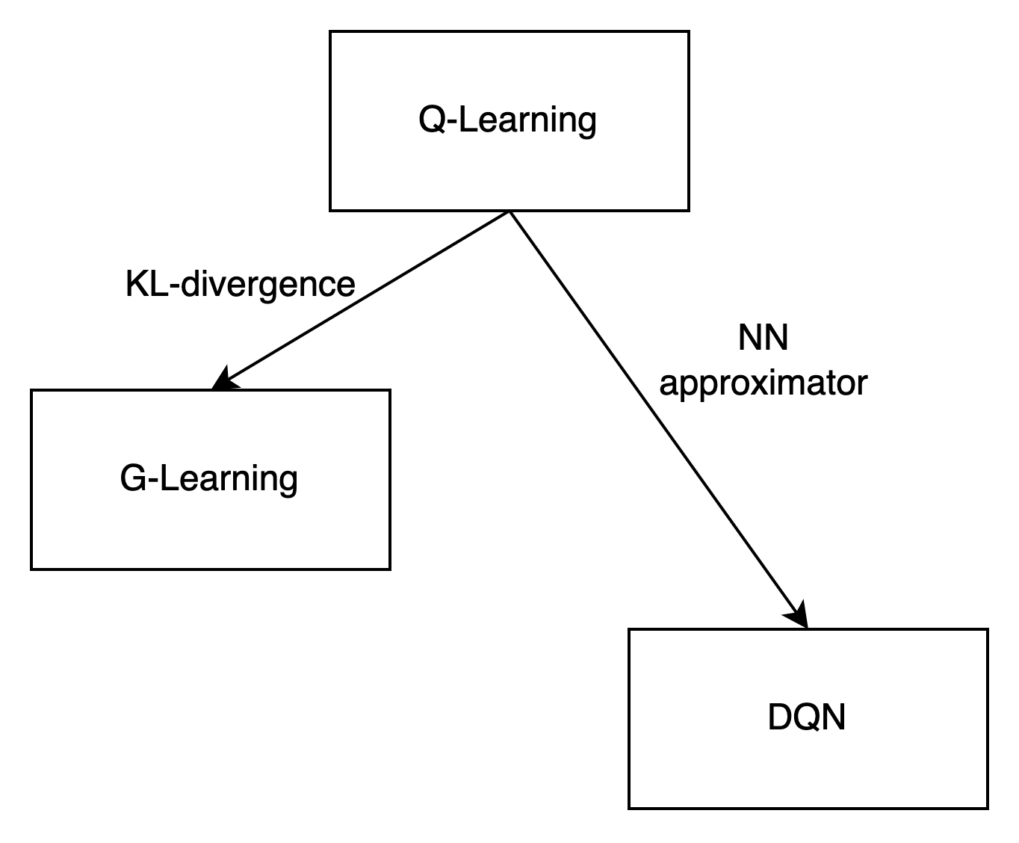
Approximation for Agent
Motivation: Agent has little probability to visit then learn policy for all states (Fig).
We can either force the agent to explore more, or infer the action for unvisited states.
We add KL-divergence against uniform distribution to force exploration (G-Learning)
We use Neural Network (NN) to approximate the Table. (DQN)
Notes:
Let’s first talk about how we do the approximation for agents. Like we said before, tabular agents like Q learning has little probability to visit and learn policy for all states. You can see on the right hand side, Q learning agent only learned limited amount of policy which is the part inside the red circle. To solve this, we can either force the agent to explore more, and that’s our g learning approach. We added KL-divergence against uniform distribution to force exploration. Or we infer the action for unvisited states, and that’s our DQN approach we used Neural Network to approximate the table.

Slide 15

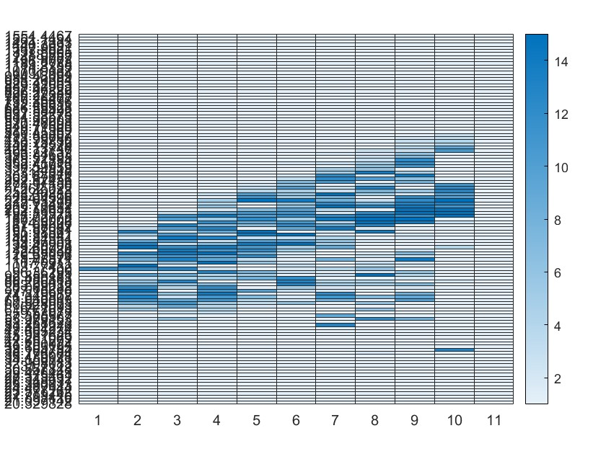
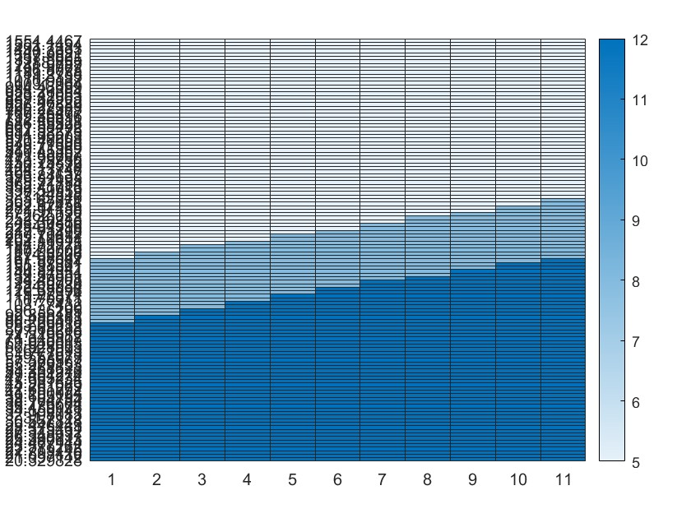
Comparison of Different Agents
Comparison of action grid and success probability
 |  | Agent
Metrics | Q-Learning | G-Learning | DQN
Success probability | 40.50% | 33% | 48%
Q-Learning
G-Learning
DQN
Notes:
Here is the comparison of their actions grids and success probabilities. DQN has the highest success rate because it has the ability to infer on states that have not been visited.

Slide 16
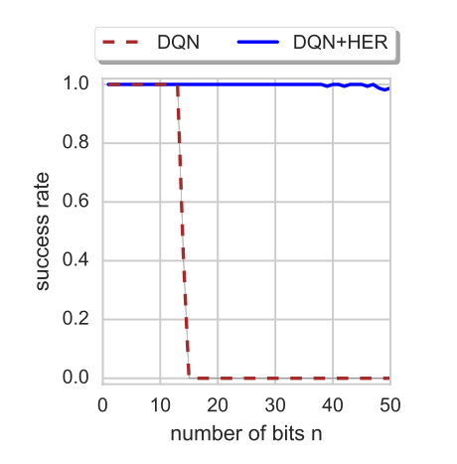
Approximation for Environment
Motivation:
Sparse reward fails to guide RL agent with large action space and environment with long episode. Therefore it is important to approximate the sparse reward with more informative reward.
For example, consider a bit-flipping game:
The action is to flip each bit or not. Reward is 1 if all bits are 1, otherwise the reward is 0.
We observe that agent fails to learn when N>20. Because it is almost impossible (2^N) to receive positive reward with random exploration.
The same applies for our case.
Notes:
The second part of the approximation method is to approximate the sparse reward with step reward.
You may ask why and the reason is that sparse reward can fail to guide RL agent. So it is important to approximate our target with more informative reward.
Here is an example of failure of sparse reward.

Slide 17
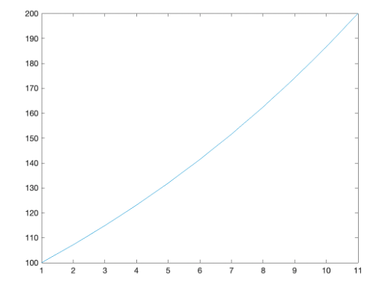
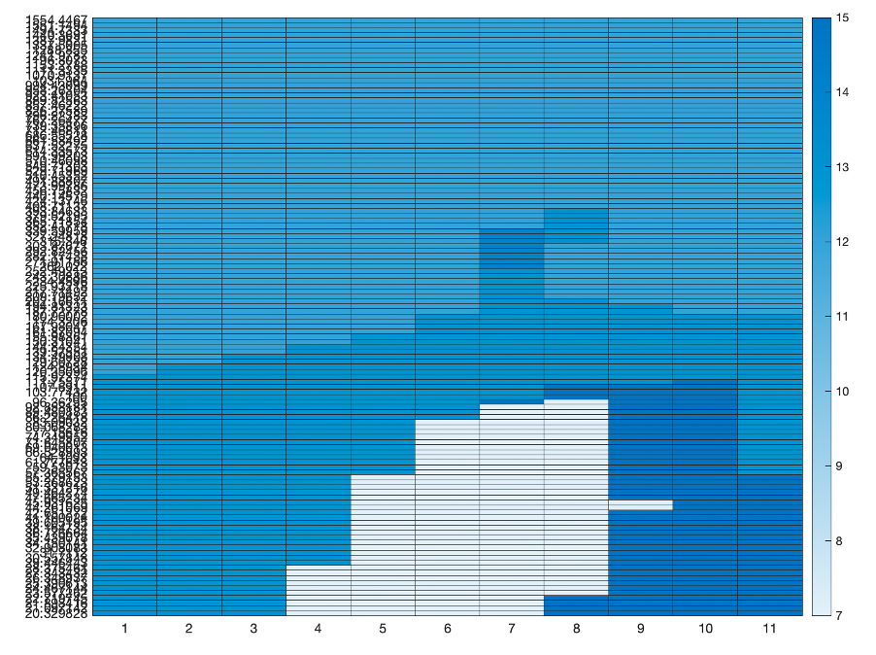
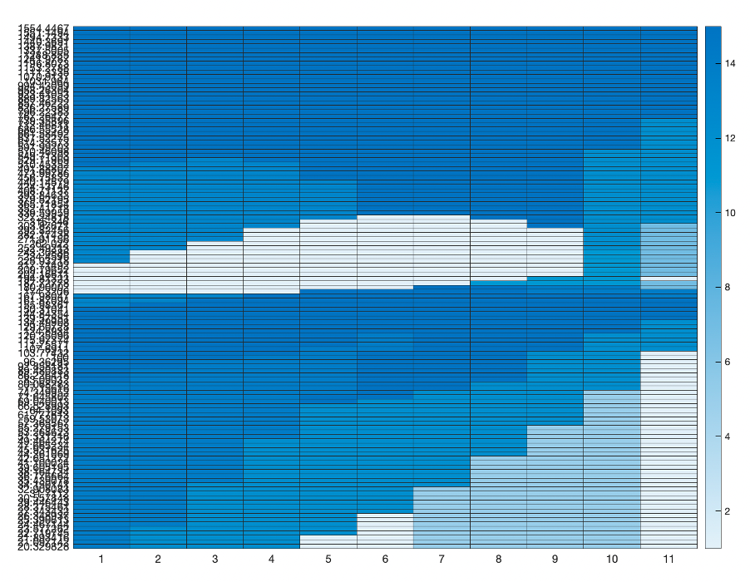
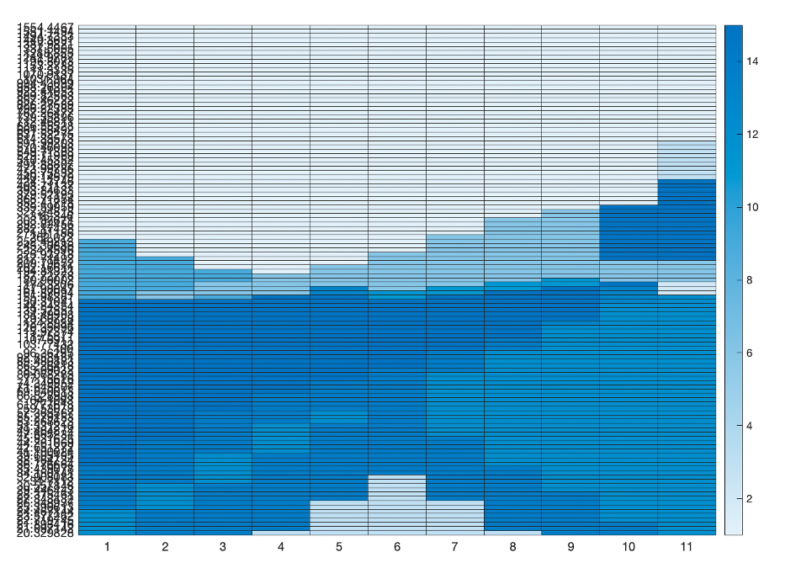
Comparison of Different Environments
Avg
Motivation and definition of three modified environments:
Line: Gives 1 reward if above a predefined curve at each step.
Scale: Gives scaled reward if goal is fulfilled at each step, the latter the larger.
Multi factors
Comparison Table
1x
1.62x
6.19x
 | Train Environment
DQN | Sparse | Line | Multifactor
Hidden units | Success probability on Sparse Env.
8 | 38.30% | 49.60% | 48.20%
16 | 48.00% | 61.00% | 47.40%
64 | 57.00% | 53.00% | 50.40%
Notes:
We developed several environments either based on our own intuition or based on research paper.
The line reward and scale reward environments are original environments, where the line reward gives positive reward if above a predefined curve at each step. The left figure is an example with wealth growing exponentially at average return. By means of curve, we could guide the agent’s behavior at different time. The scale reward gives scaled reward if goal is fulfilled at each step, the latter the larger. You can see the three action grids where the last reward is 1, 1.6 and 6 times to the first reward. The agent becomes defensive as we expected and identical to the DP result. The multi factors reward is an implementation of a relevant paper that aggregates max drawdown, sharpe ratio and etc.
We present our DQN experiment results on the three environments. We have observed a significant improvement compared with the sparse setting. And the best result is DQN with 16 hidden units on line reward environment, which is 61%. So how good is our result?

Slide 18
Performance of the System
Only -0.07 away from theoretically highest success rate!!!
Notes:
Only minus zero point zero seven away from theoretically highest success rate. The model can provide a solution that is very close to the optimal solution.

Slide 19
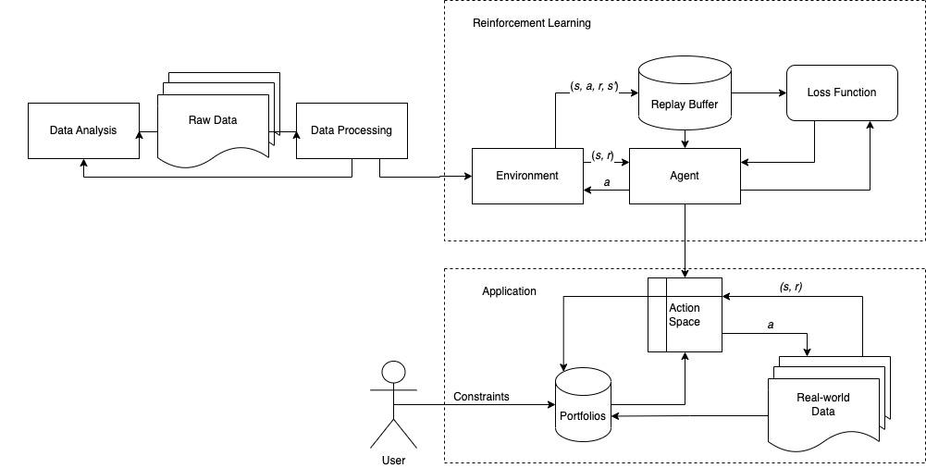
Overview of the System
Notes:
And this is a review of our reinforcement learning system. We first collected raw data and preprocessed the data. Then we conducted data analysis on our data to observe the statistic features. Then the data is set for our environments in reinforcement learning algorithm. To explore the best result, we trained different agents with different environments and tested on the environment identical to the DP setting. After comparing the result, we used the best agent to be the backend of our application. For our Goal-based wealth management application, the user can set their preference to present the set of feasible portfolios. And our agent choose the portfolio among them to interact with the real world.

Slide 20


THANK YOU
Notes:
This is the end of presentation. We are now open to any questions. Thank you

Slide 21
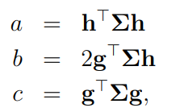
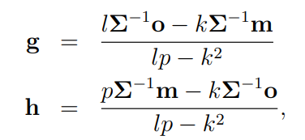
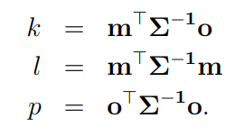
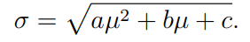
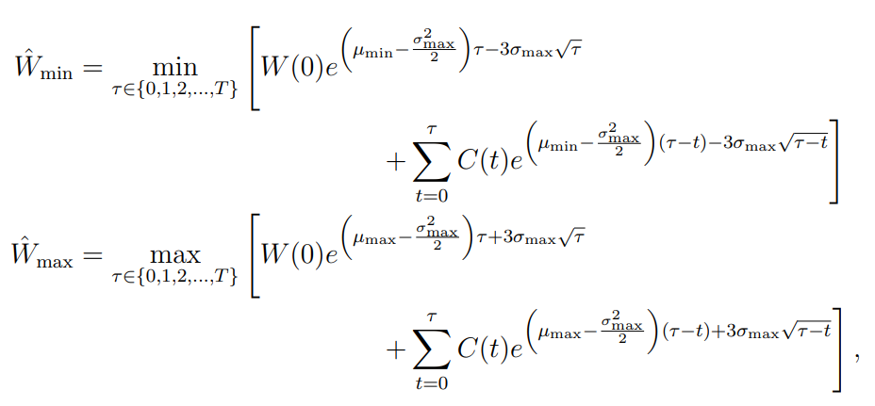
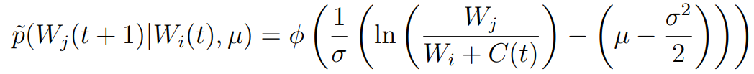
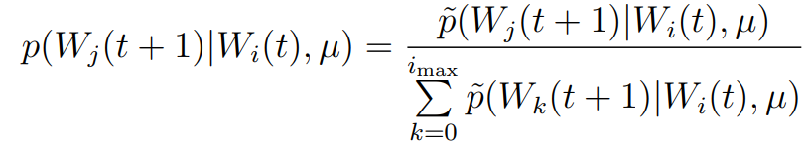
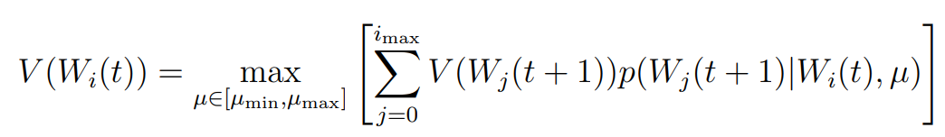
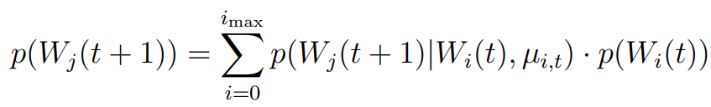
Quick Review of Paper and DP model based on it
efficient frontier:
smallest and largest
wealth grid point
probability density
function:
transition
probabilities:
probability
distribution:

Slide 22
Quick Review of Paper and DP model based on it
Inputs: Initial wealth W0, Target wealth G, Time horizon T
Goal: max Pr[W(T) ≥ G]
Algorithm:
Step 1: calculate efficient frontier for stock portfolios
Step 2: set state space grid points
smallest wealth grid point = smallest possible wealth, largest wealth grid point = largest possible wealth
Step 3: dynamic programming for optimizing the chance of obtaining the investor’s goal
get transition probabilities from probability density function
determine Bellman recursion equation to know V (W(0)), optimal probability
Step 4: determine the probability distribution for the investor’s wealth

Slide 23
Something need improve
The original model has a limited number of observable states
But wealth is a continuous variable
The number of portfolio is fixed and determined before action
We need to know transition probabilities function,
Requires a lot of mathematical calculations
RL can learn in the case of transitions unknown
Our experiments still use DP's transition to facilitate comparison

